Slide 1

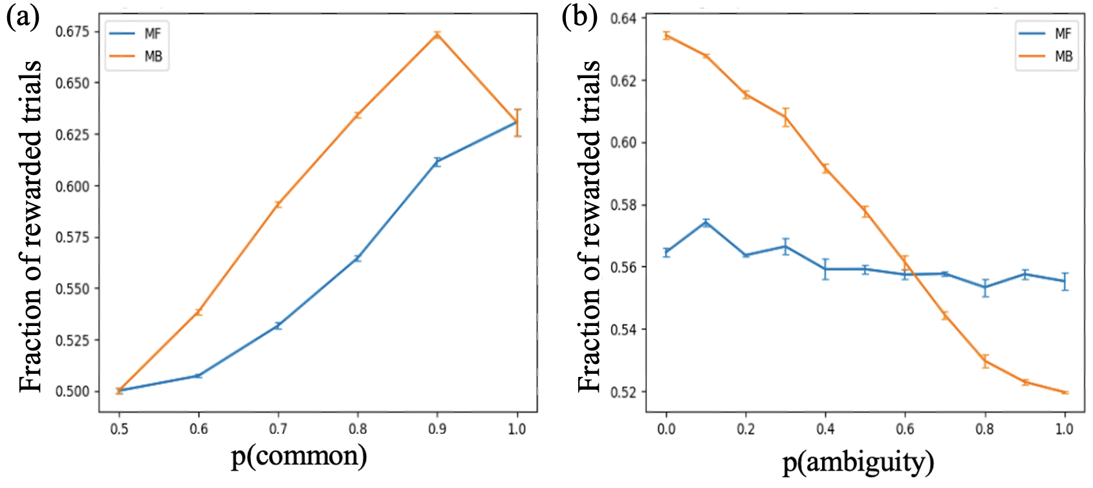
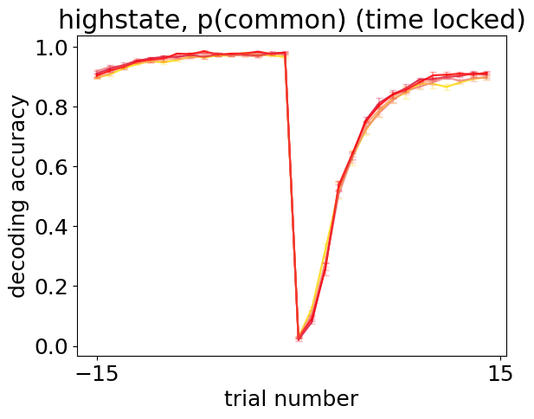
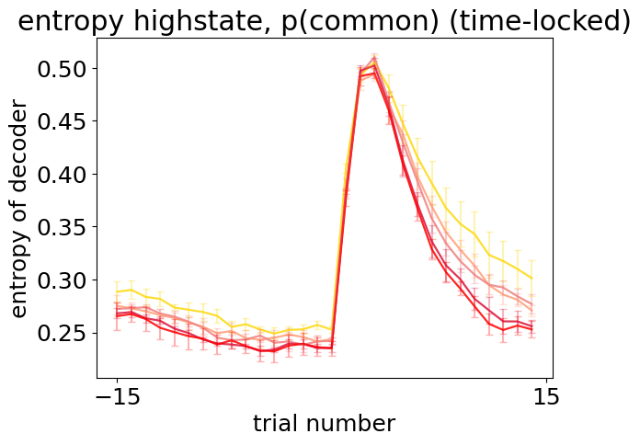
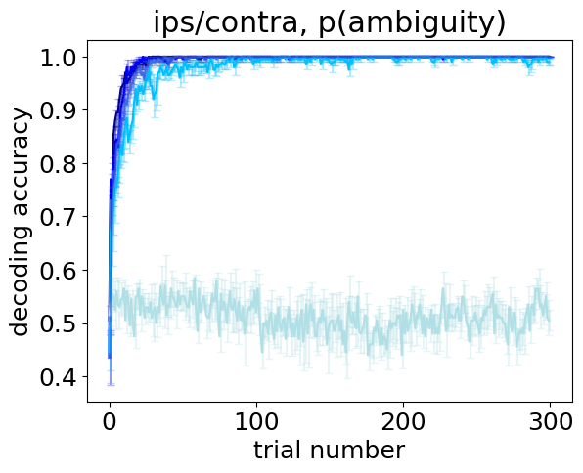
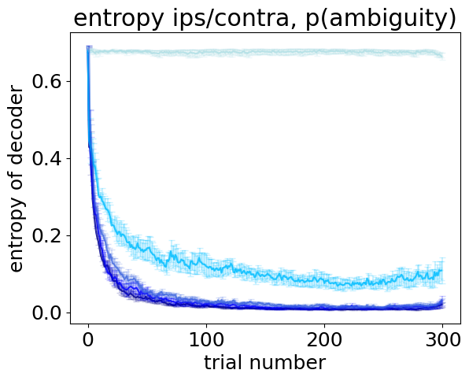
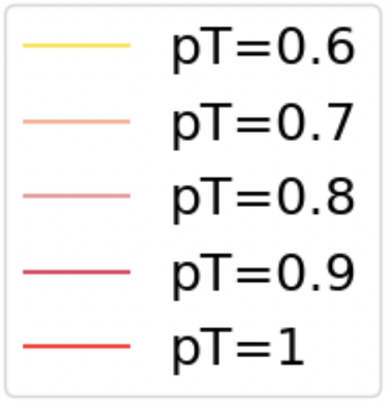
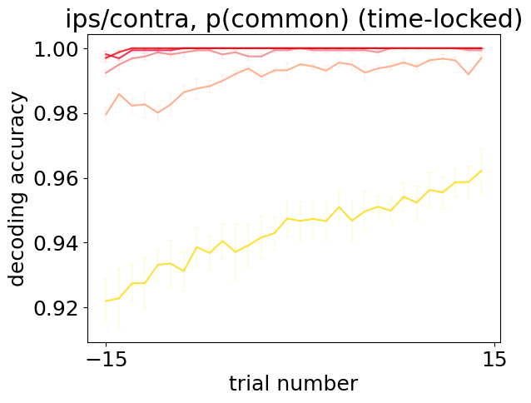
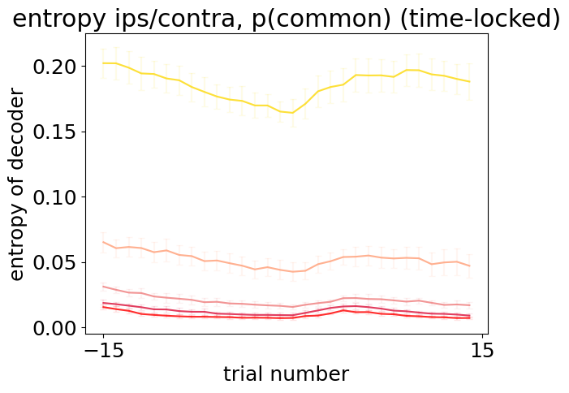
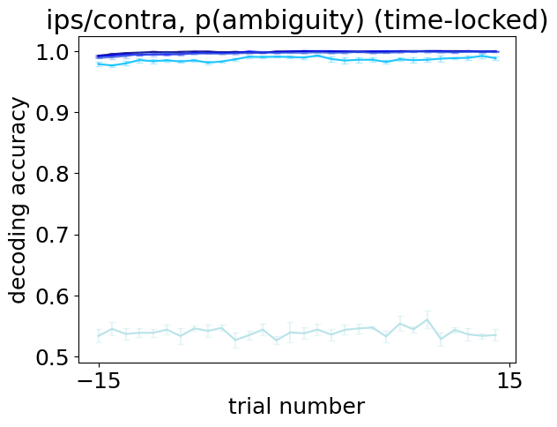
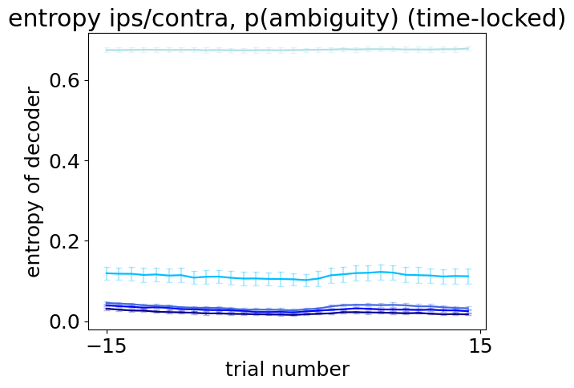
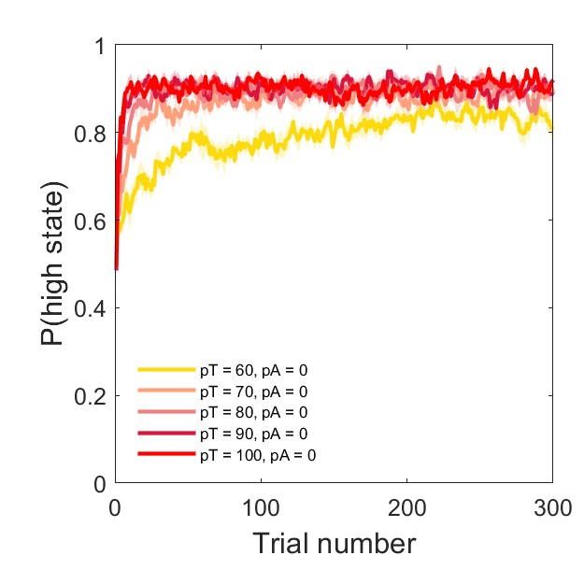
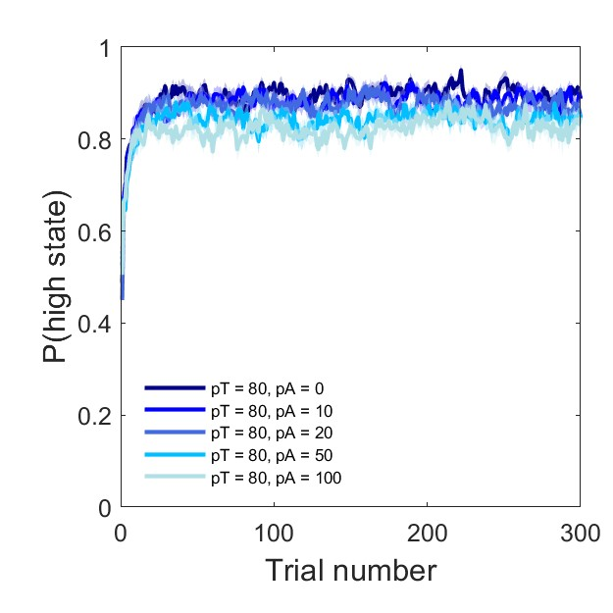
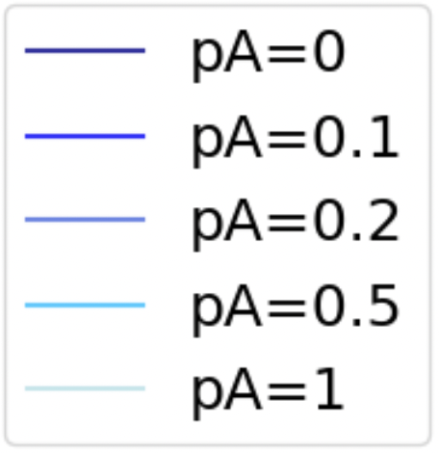
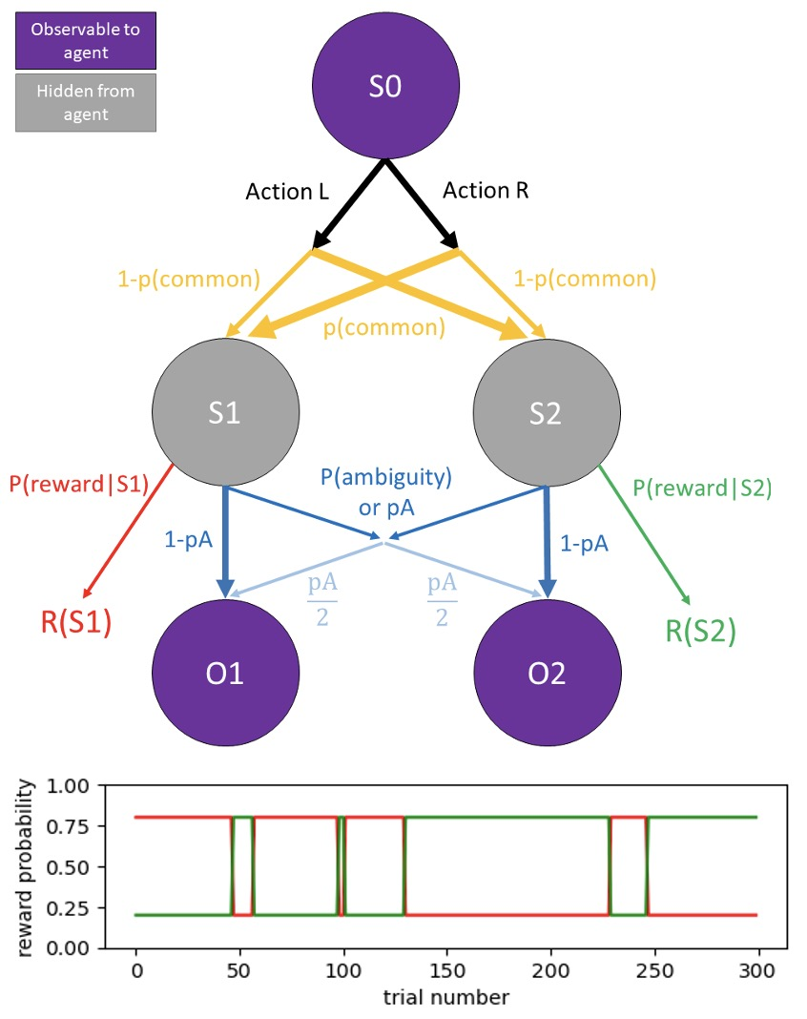
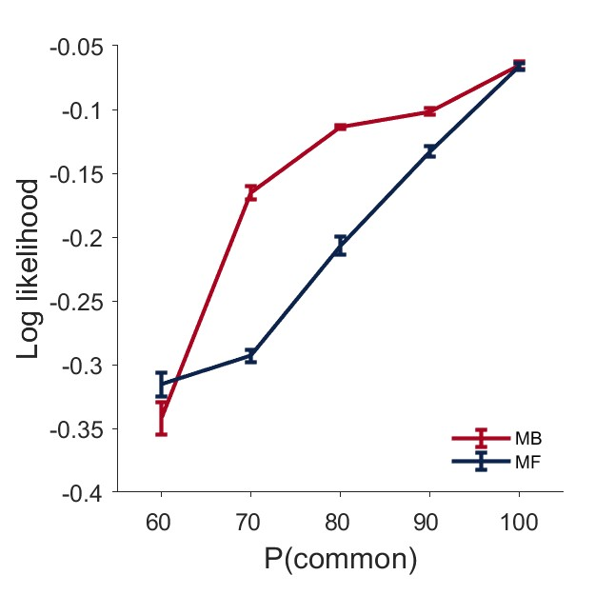
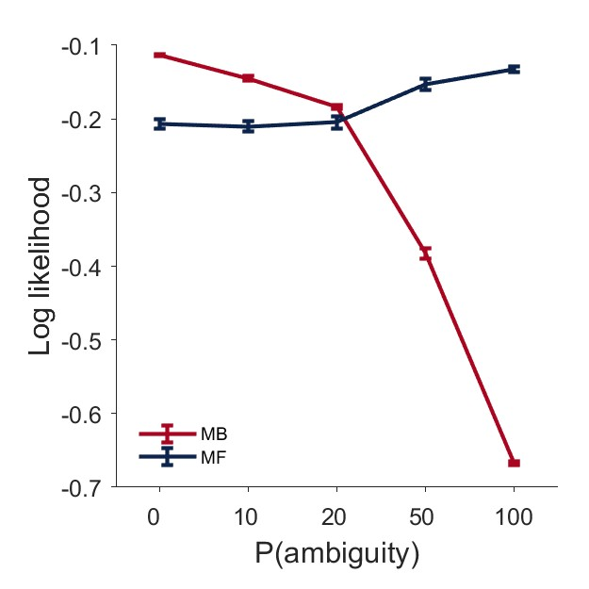
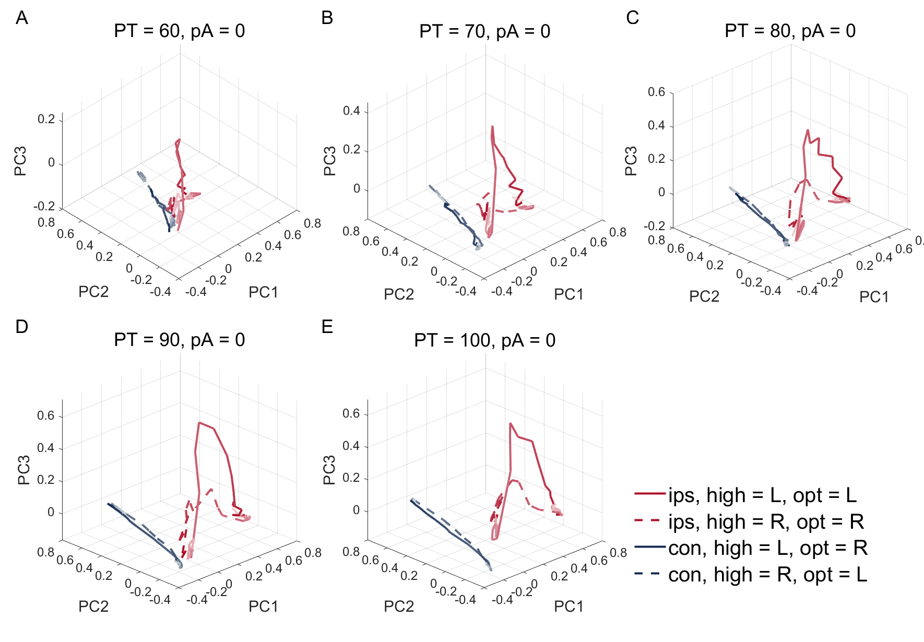
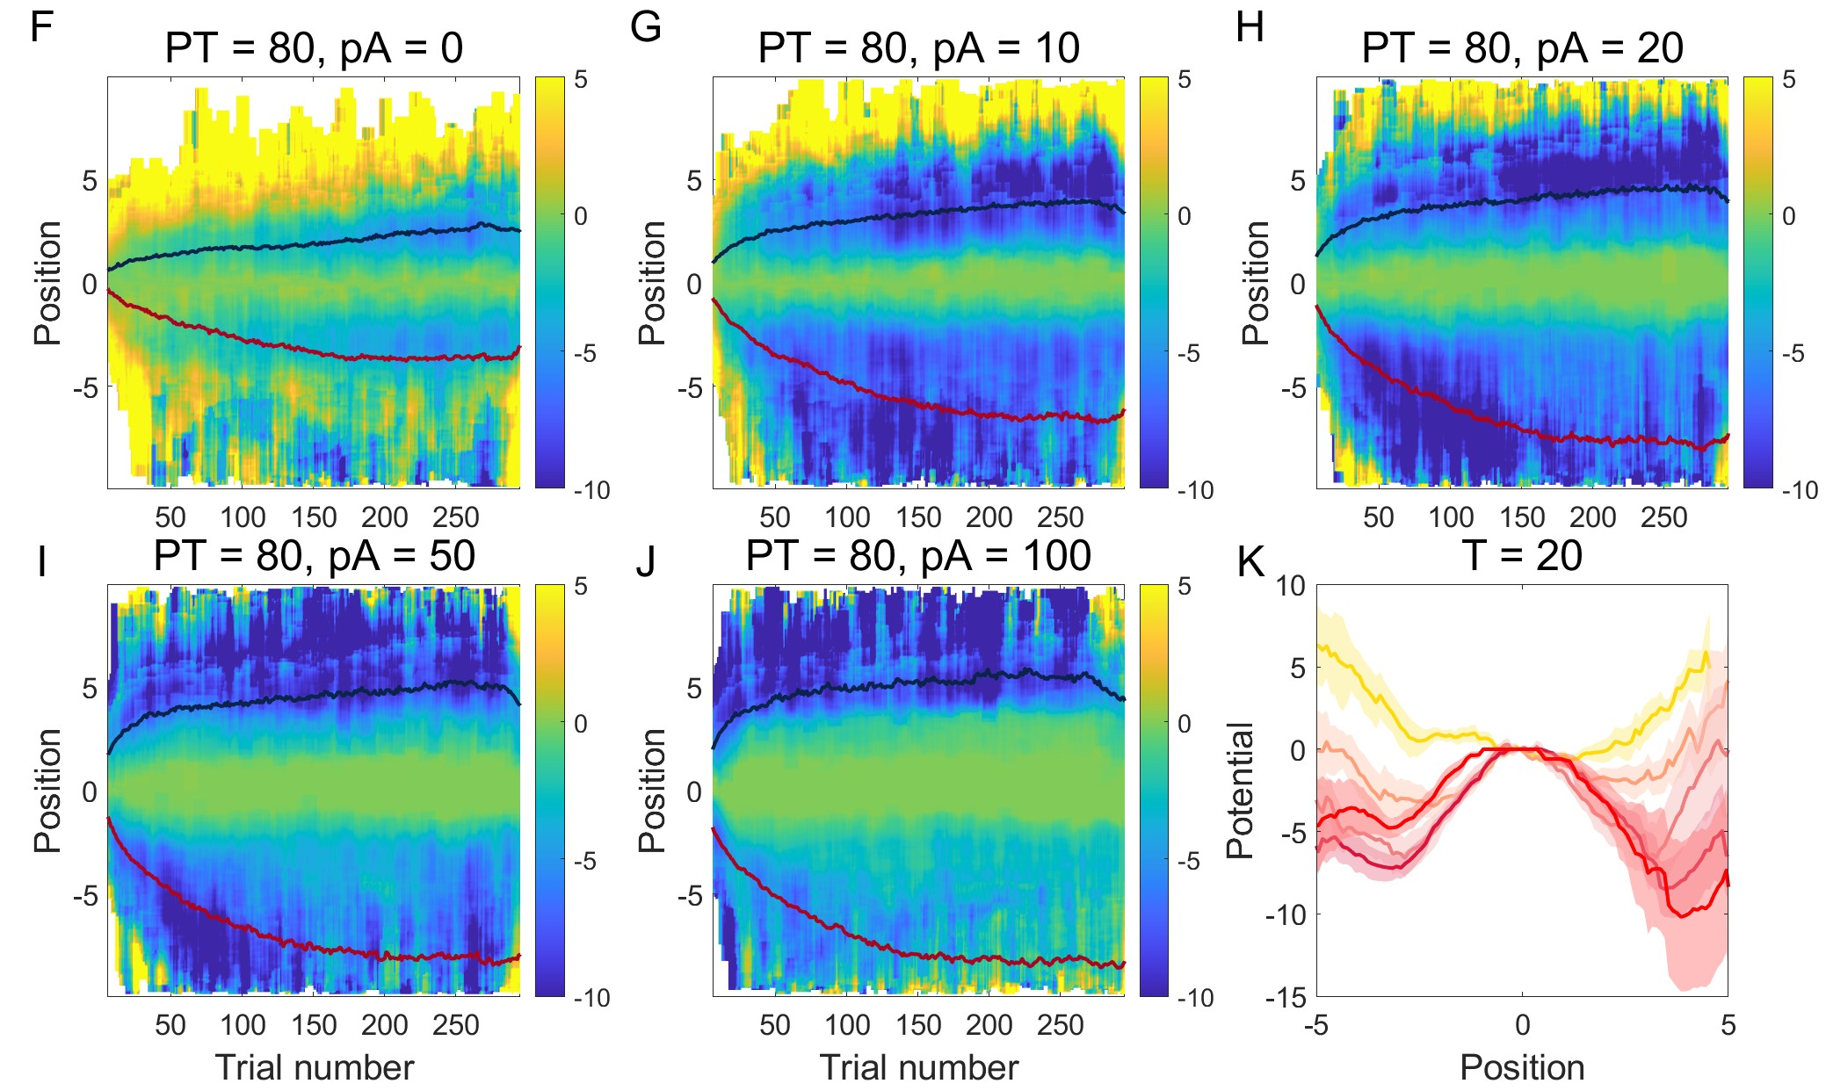
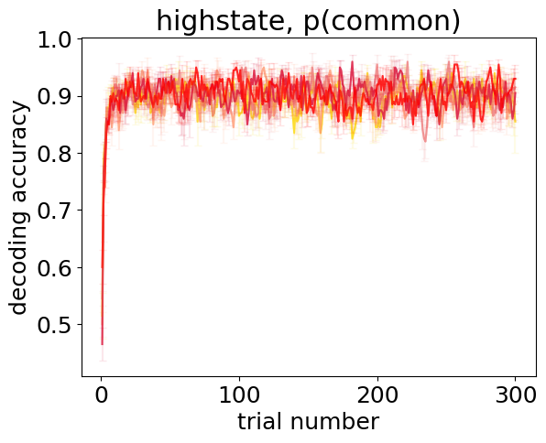
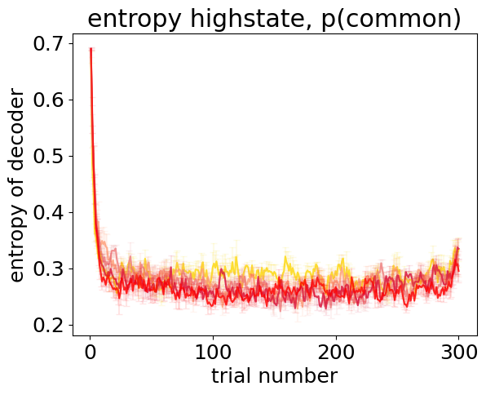
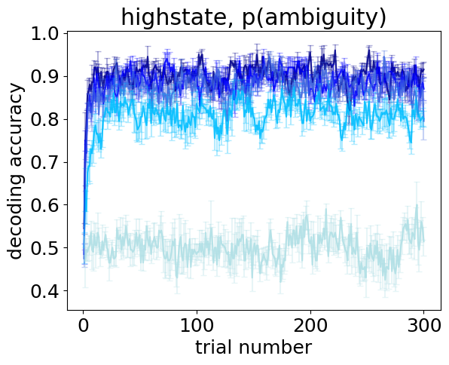
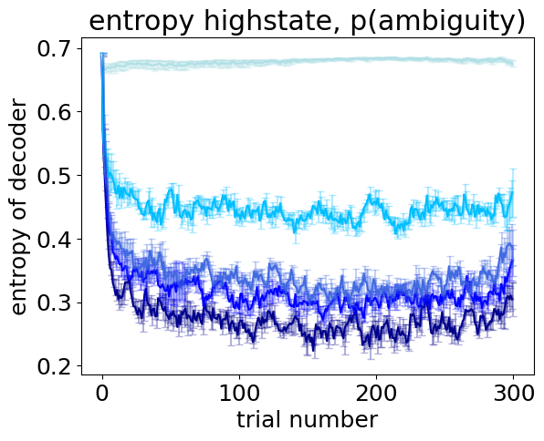
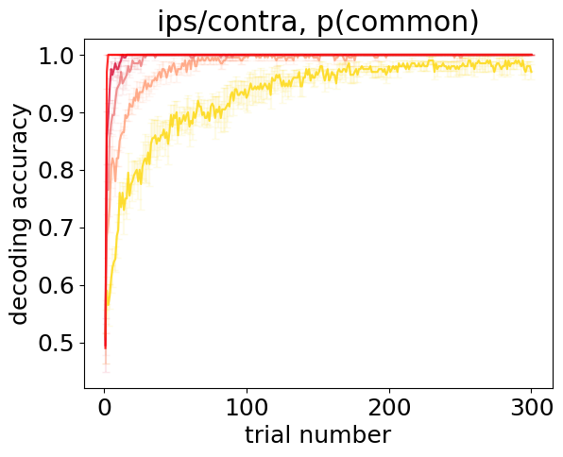
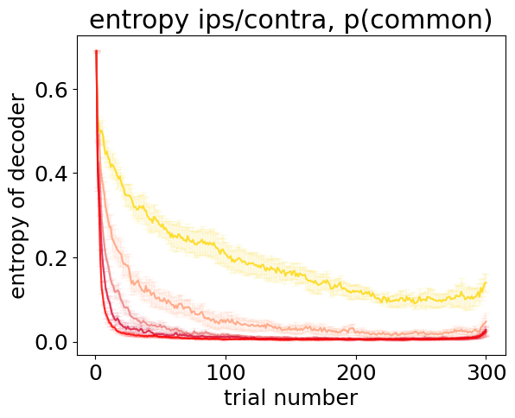
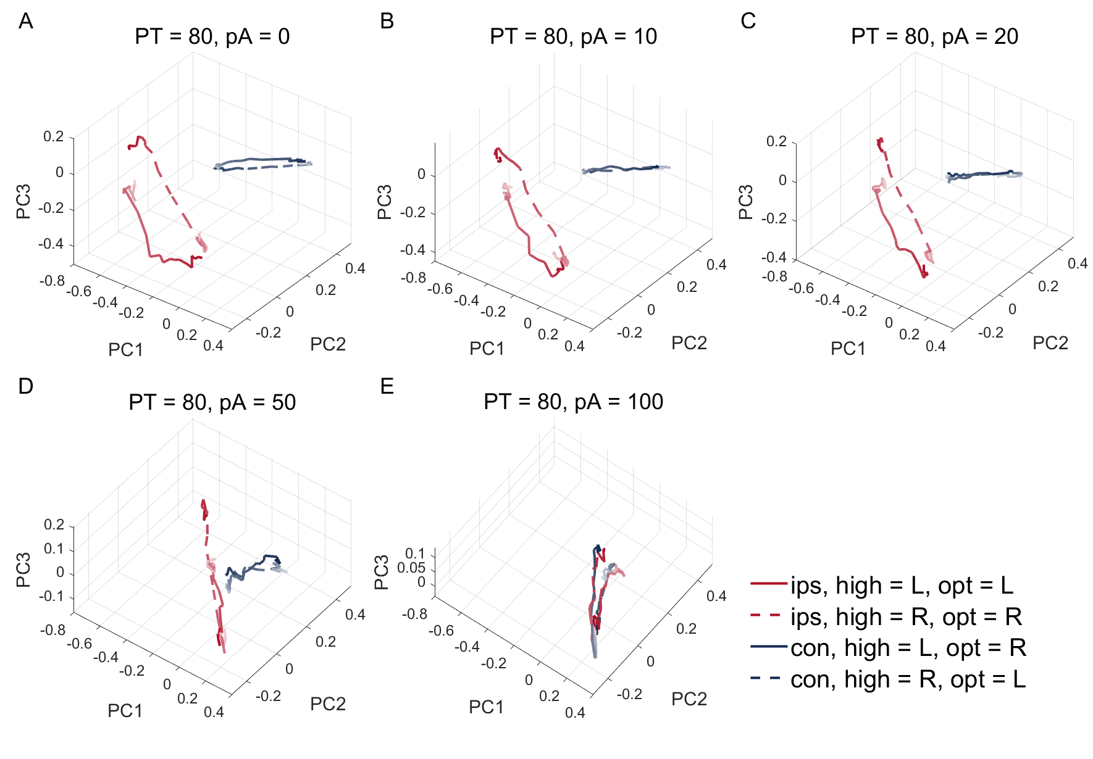
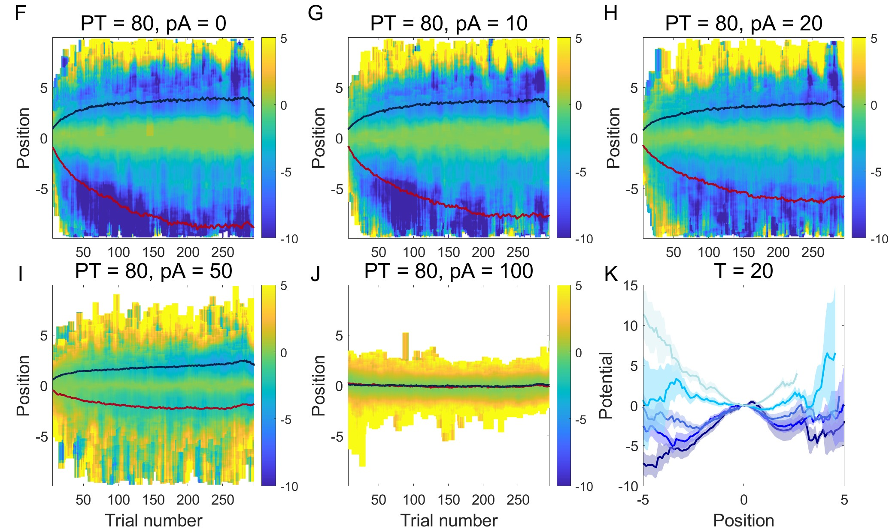
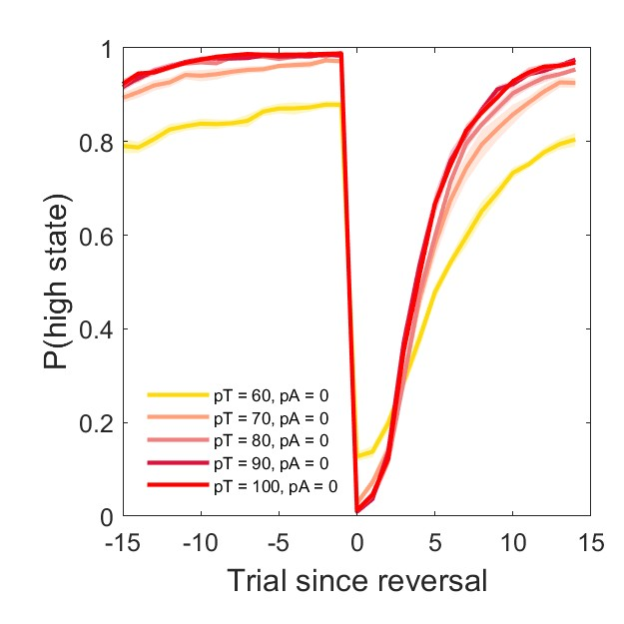
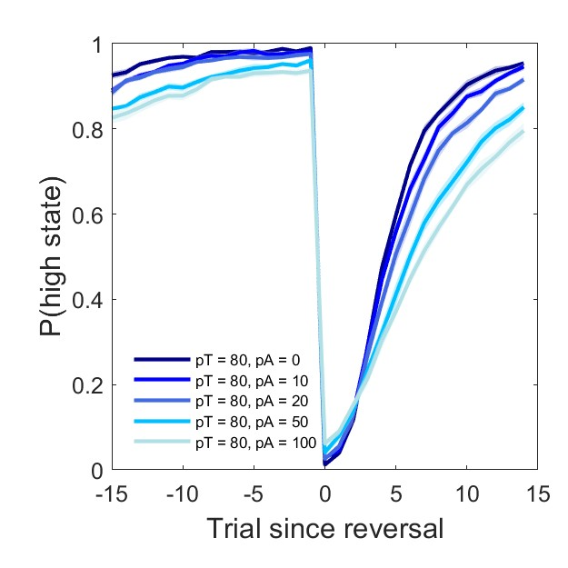

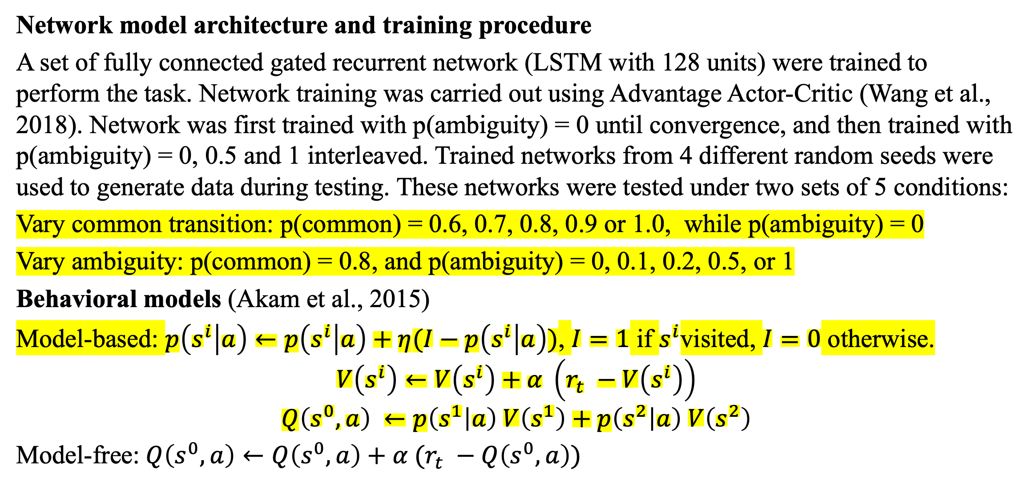
The role of state-transition certainty in the arbitration between model-based and model-free reinforcement learning Jiachen Liu¹ and Siyu Wang² ¹Neuroscience and Cognitive Science, University of Maryland, College Park ²National Institute of Mental Health, NIH
Introduction
Results
Humans and animals sometimes build models of the world to facilitate learning. In Model-based (MB) reinforcement learning, agents utilize internal predictions of the environment (e.g., estimate of state transitions) to guide action selection. In model-free (MF) reinforcement learning, on the other hand, actions are learned without using such environment models. The arbitration between MB and MF systems has been studied from the perspective of a cost-benefit tradeoff between computational expenses and model flexibility. It has been suggested that when state-transition uncertainty is high, humans tend to resort to MF strategies (Kim et al., 2019). However, the network computational mechanisms underlying the arbitration between MB and MF systems remains unclear. In this work, we investigated how artificial recurrent network agents arbitrate between MB and MF systems when performing a modified version of the two-step task (Daw et al., 2011, Akam et al., 2015). By examining the network representation of state-transition certainty, our data suggested a potential mechanism for the arbitration between MB and MF reinforcement learning.
Behavior of optimal MB and MF agents under different task conditions
Fig.2 Model-free and model-based agent’s performance in (a) different common transition rate, (b) different ambiguity rate.
This allowed us to train network models which flexibly display MB and MF behavior in different common transition and ambiguity
conditions.
Decoding of high/low reward state, and state-transition context during reversal
Behavior of trained network
Fig.3 Network performance over time for different common transition (Left) and ambiguity (Right) conditions.
Network performs worse when state transition is lower, and when ambiguity is higher.
Fig. 7. Decoding of population LSTM cell activity time-locked to reversal. (a) decoding of high reward state over time in different common transition probability conditions. (b) entropy of the decoders in (a). (c) decoding of state-transition context (ipsilateral vs contralateral) over time in different common transition probability conditions. (d) entropy of the decoders in (c). (e-h) Same as (a)-(d), for different ambiguity conditions.
Methods
Task
At state S0, agent decides to go to either state S1 or S2 to obtain rewards. In ipsilateral trial blocks, the probability of arriving at the state the agent intends to go equals p(common), with probability 1-p(common) arriving at the unintended state. In contralateral trial blocks, the transition rate is flipped, with probability p(common) arriving at the state the agent did not choose to go. Complementary probabilistic rewards (80% vs 20%) are issued depending on which state the agent arrives. One of the states S1, S2 is randomly assigned to be the high-rewarding state (0.8 reward rate), with the other being low-rewarding state (0.2 reward rate) at beginning of each block, with a 0.02 chance flip from trial to trial within a block. Crucially, the agent can not directly observe the state arrived: with probability ½ p(ambiguity), the observed state would disagree with the true state the agent arrives and with remaining probability the observed state would agree with the true state. Each block consists of 300 trials, with p(common) and p(ambiguity) randomly assigned at beginning of each block and stays fixed within a block.
Population dynamics reflects model certainty
(a)
We examined population network activity in the state space spanned by the activity of individual units. Principal component analysis was carried out to reduce the dimensionality. The low-dimensional population trajectory during reversal were visualized for different common transition (Fig.8 A-E) and ambiguity (Fig. 9 A-E) conditions. Crucially, population activities in ipsilateral transition context (when p(S1|L) > 0.5) and contralateral transition context (when p(S2|L) > 0.5) occupied different subspace. Presumably, model-based RL was carried out when activity enter one of the two state transition context zones.
Fig.4 Model comparison between model-based and model-free RL in different common transition (Left) and ambiguity conditions (Right).
Network behavior shows more model-based behavior in intermediate p(common) and low p(ambiguity) conditions.
Support vector machine was used to define the dimension that best separates ipsilateral vs contralateral transition context. Energy landscapes were constructed in this dimension. We found that energy landscapes were shallower when state transition was uncertain (Fig. 8 F-K), or when ambiguity was high (Fig. 9 F-K). The depth of the basins reflect model certainty and provides an explanation for the arbitration process.
(b)
Decoding of high/low reward state, and state-transition context
(a)
(b)
(e)
(f)
Fig.1 (a) Task structure of the modified two-step task, with the contralateral trial blocks plotted as an an example. (b) Reward probability trace of second stage states for one example block.
(c)
(d)
(g)
(h)
Fig.8. (A) - (E) Low-dimensional trajectories of mean population network activity during reversal, in different common transition conditions. (F) – (J) Energy landscape along the coding dimension of state-transition context (ips vs con). (K) Energy landscape at trial number 20.
Network model architecture and training procedure
A set of fully connected gated recurrent network (LSTM with 128 units) were trained to perform the task. Network training was carried out using Advantage Actor-Critic (Wang et al., 2018). Network was first trained with p(ambiguity) = 0 until convergence, and then trained with p(ambiguity) = 0, 0.5 and 1 interleaved. Trained networks from 4 different random seeds were used to generate data during testing. These networks were tested under two sets of 5 conditions:
Vary common transition: p(common) = 0.6, 0.7, 0.8, 0.9 or 1.0, while p(ambiguity) = 0
Vary ambiguity: p(common) = 0.8, and p(ambiguity) = 0, 0.1, 0.2, 0.5, or 1
Behavioral models (Akam et al., 2015)
Model-based: $p\left(s^{i} | a\right)←p\left(s^{i} | a\right)+η(I−p\left(s^{i} | a\right))$, $I=1$ if $s^{i}$visited, $I=0$ otherwise.
$$V\left(s^{i}\right)←V\left(s^{i}\right)+α \left(r_{t} −V\left(s^{i}\right)\right)$$
$$Q\left(s^{0}, a\right) ←p\left(s^{1} | a\right) V\left(s^{1}\right)+p\left(s^{2} | a\right) V\left(s^{2}\right)$$
Model-free:$Q\left(s^{0}, a\right)←Q\left(s^{0}, a\right)+α (r_{t} −Q\left(s^{0}, a\right))$
Fig.5 Decoding of population LSTM cell activity. (a) decoding of high reward state over time in different common transition probability conditions. (b) entropy of the decoders in (a). (c) decoding of state-transition context (ipsilateral vs contralateral) over time in different common transition probability conditions. (d) entropy of the decoders in (c). (e-h) Same as (a)-(d), for different ambiguity conditions.
Network behavior during reversal (high/low-rewarding state flip)
Fig.6 Network performance time-locked to the onset of high/low-rewarding state flip for different common transition conditions (Left) and ambiguity (Right) conditions.
When state transition is more certain, and when ambiguity is low, it takes fewer number of trials for the network to adapt its behavior after reversal.
Fig.9. (A) - (E) Low-dimensional trajectories of mean population network activity during reversal, in different ambiguity conditions. (F) – (J) Energy landscape along the coding dimension of state-transition context (ips vs con). (K) Energy landscape at trial number 20.
References
Summary
Akam, T., Costa, R., & Dayan, P. (2015). Simple Plans or Sophisticated Habits? State, Transition and Learning Interactions in the Two-Step Task. PLoS Computational Biology, 11(12), 1–25. https://doi.org/10.1371/journal.pcbi.1004648
Daw, N. D., Gershman, S. J., Seymour, B., Dayan, P., & Dolan, R. J. (2011). Model-based influences on humans’ choices and striatal prediction errors. Neuron, 69(6), 1204–1215. https://doi.org/10.1016/j.neuron.2011.02.027
Kim, D., Park, G. Y., O′Doherty, J. P., & Lee, S. W. (2019). Task complexity interacts with state-space uncertainty in the arbitration between model-based and model-free learning. Nature Communications, 10(1). https://doi.org/10.1038/s41467-019-13632-1
Wang, J. X., Kurth-Nelson, Z., Kumaran, D., Tirumala, D., Soyer, H., Leibo, J. Z., Hassabis, D., & Botvinick, M. (2018). Prefrontal cortex as a meta-reinforcement learning system. Nature Neuroscience, 21(6), 860–868. https://doi.org/10.1038/s41593-018-0147-8
.
- We trained network models that exhibit both model-based and model-free behavior under different task conditions.
- Decoding analysis of the network cell activities showed that the extent to which the agent shows model-based behavior is reflected in the extent to which state-transition context can be decoded from the network activities.
- State-space analysis of the population activity suggests that geometry of attractor basins, in the coding dimension of state-transition context, reflects model certainty. Future work will examine how this certainty representation guides the arbitration between model-based and model-free reinforcement learning.

